Slide 1



Translating Words, Trees and Statistics
Adrien Vieilleribière
Jury:
Niehren Joachim, reviewer
Laurent Dominique, reviewer
Bidoit Nicole, examiner
Tanaka Yuzuru, examiner
de Rougemont Michel, adviser
Paris-Sud University
22/09/2008
Notes:
This work is about approximate dAta exchange.
This is a joint talk with my phd adviser Michel de Rougemont.

Slide 2
MotivationS
  Interoperability
      Exchange data between different Schemas.
      Visualization.
Manage Huge and Imperfect Data
      Robustness to noise.
      Decisions based on statistics.
Approximation and Complexity
Notes:
Practical : exchange files in diff format for the purpose of visualization
Theoretical : bring approximation in the picture

Slide 3
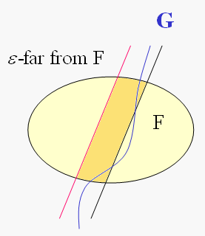
APPROXIMATION : intuition
Satisfiability : T |= F_{DTD}
Approximate Satisfiability : T |= F_{DTD}
Approximate Equivalence
Notes:
We’ll approximate decision problems and this means explanations
Let T be a tree and F the property to satisfy a given DTD.
In the classical situation, this property divides trees into two Areas, those satisfying the DTD and those not satisfying the DTD.
In our case, we have three areas:
Trees satisfying the DTD where we want to accept.
Instances far from satisfying the DTD on which we want to reject with high probability
And the area between where we do not guaranty the result.
The goal is to define distances between schemas and for example the notion saying that two dtd approximatively accept the same trees.

Slide 4
Outline
  I Word distance and uniform statistics
          Words
          Automata
I I Approximate Equivalence of FSM
          Statistical Embedding
          Soundness
          Robustness
III Trees
          Statistics
          XSL-transducers
IV Approximate Data Exchange
          ε-Consistency
          ε-Type-checking
V Applications
          Visualization for OLAP queries
Notes:
One of the main motivation is to deal with data sources which may be imperfect
We therefore need a precise notion of approximation for MC problems
We will use an approximation based on a statistical representation of words, trees and transducers

Slide 5
I DISTANCES & STATISTICS For Words
Edit distance with moves
Uniform Statistic
Linking these notions
  Words
      Soundness
      Robustness
  Automata
Notes:
I first start with the classical data exchange
then introduce the approximation based on property testing
and finally comes to the main subject which is approximate data exchange

Slide 6
Edit Distance With Moves
  Edit Distance : Insertions, Deletions, Modifications
  Moves
0111000011110011001
0111011110000011001
Notes:
Distance with moves is a specific generalization of the classical edit distance with a new atomic operator which allows to move in one step a consecutive bloc of letters into another position
On trees, it considers insertion and deletion of a node and an edge, change the label of a node, and the move operation consists in moving a subtree into another position

Slide 7
Word Statistic
W=001010101110
length n : n-k+1 blocks of length k
For k=2, n=12, 11 blocks
Notes:
I first start with the classical data exchange
then introduce the approximation based on property testing
and finally comes to the main subject which is approximate data exchange

Slide 8
Soundness and Robustness
Soundness: ε-close strings have close statistics
Robustness: ε-far strings have far statistics
Approximate Satisfiability and Equivalence
E. Fischer, F. Magniez, M. de Rougemont, LICS06.
Notes:
Now we see the representation of a regular language in the space of statistics.
H is defined by the set of the statistics of all the words in the language and we can show that H is a union of polytopes.
Lets keep k=2, each summit of a polytopes corresponds to a loop of the given expression and this expression generates 2 polytopes
We have now a membership tester to decide if a word is close to the regular expression :
It approximates ustat(w) by Y (with sampling), then compute the geometrical distance beetween this vector and H and accept if and only if this geometrical distance is small.

Slide 9
Statistics of a Schema
r = (010)*0*1* + 1*(01)*(110)*
H={u.stat(w) : w in r } is approximated by a union of polytopes.
2 polytopes for r.
Notes:
Now we see the representation of a regular language in the space of statistics.
H is defined by the set of the statistics of all the words in the language and we can show that H is a union of polytopes.
Lets keep k=2, each summit of a polytopes corresponds to a loop of the given expression.

Slide 10
II AppROXIMATE EQUIVALENCE for FSM
Statistical Embedding
  Example & Definitions
  Close FSM have close embeddings
  Far FSM have far embeddings
Decision
  Compute the embeddings and test inclusion on a discrete grid.
Notes:
I first start with the classical data exchange
then introduce the approximation based on property testing
and finally comes to the main subject which is approximate data exchange

Slide 11
Finite State Machine
    Determinism : lhs determines rhs ?
Inclusion
Approximate inclusion
Notes:
A FSM consists in … and a transition relation :
given a state and a label (lhs),
it allows to output a word and continue the transformation on the state given on the rhs

Slide 12
EQUIVALENCE of FSM
Hard problem
      Undecidable equivalence for non-deterministic transducers (one way, finite state, even when they cannot read or write the empty string) [Griffiths, 1968]
      Equivalence is at least PSPACE-hard, even restricted to transitions (a,q)->(a,q’)
Decidable
      For deterministic transducers [Bird 1973, Valiant 1974]
      With prefix condition [Karhumäki & Lisovik, 1999]
Approximate version
Notes:
In the classical situation, a property divides a class of structure into two Areas, those satisfying the property and those not satisfying the property. In our case, we have three areas:
Instances satisfying the property where we want to accept. Instances far from satisfying the property on which we want to reject with high probability And the area between where we do not guaranty the result.

Slide 13
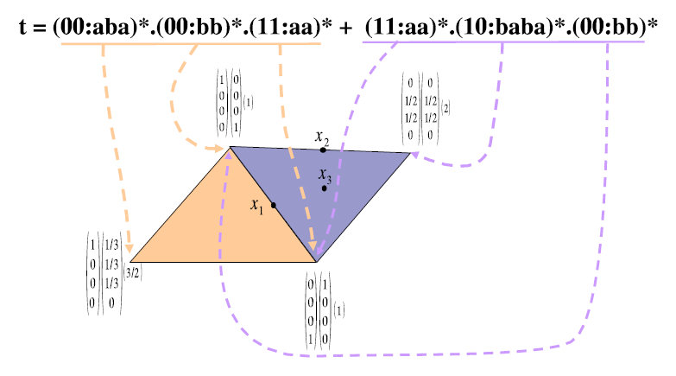
Statistics for FSM

Slide 14
Embedding for FSM : definition
  For a loop of length ≤ mk² :
  (asymptotic input statistic ,asymptotic output statistic, distortion)
For a set of compatible loops and a decomposition
For a set of compatible loops
For a FSM
Remark : H only depends on the transformation, not on a specific representation

Slide 15
SOundness
Lemma : Let k=1/ε be an integer, τ a FSM,
w large enough and then, there is
Such that
Example
Corollary (with soundness on words) :
Notes:
Regroup similar loops together (moves)
Few uses of a loop -> negligible effect on the statistics
Real use of a loop -> edge effect negligible

Slide 16
ROBUSTness
  Lemma
Lemma 1 : far long couple implies far witness sequence
  (w,w’) in τ₂ ε-far from any couple in τ₁
  (ustat(w),ustat(w’),|w’|/|w|) is close to a point P in H₂.
  P can be decomposed on a base of fixed size (d+1 elements by Caratheodory theorem)
  At least one of these is still far from H₁: P’=(x,y,l)
  There is a witness sequence of couples (w_{i},w_{i}’) in τ₂
Lemma 2 : the statistics of the witness sequence is far from H1.
  P’ is close H₂ (P’ comes from a set of compatible loops)
  By construction, (w_{i},w_{i}’) are still far from the couples of τ_{1.}
  By robustness on words, P’ is far from H₁.
  H₂ is far from H₁.
Notes:
(set of compatible loops of length less than c.m.k²)

Slide 17
Construction of H
Direct approach
  Combine ustat of compatible loops of length
  H in time
Improvement : Do not consider all loops, only their statistics.
  Up to length p : polynomial number of points (in p).
  Inductive combination of two sets of statistics
    For this can be achieve by matrix multiplication on an adapted algebra
    The same works if all rhs of rules are of same size
Naive Exponential Construction
PTIME Construction
for letter to letter transducers
Notes:
Now we see the representation of a regular language in the space of statistics.
H is defined by the set of the statistics of all the words in the language and we can show that H is a union of polytopes.
Lets keep k=2, each summit of a polytopes corresponds to a loop of the given expression and this expression generates 2 polytopes
We have now a membership tester to decide if a word is close to the regular expression :
It approximates ustat(w) by Y (with sampling), then compute the geometrical distance beetween this vector and H and accept if and only if this geometrical distance is small.

Slide 18
ConsEQUENCEs
Theorem :
For FSM with transitions in
  ε-inclusion is decidable
Theorem :
For FSM with transitions in
  ε-inclusion is in PTIME
  inclusion is PSPACE-hard
Notes:
Now we see the representation of a regular language in the space of statistics.
H is defined by the set of the statistics of all the words in the language and we can show that H is a union of polytopes.
Lets keep k=2, each summit of a polytopes corresponds to a loop of the given expression and this expression generates 2 polytopes
We have now a membership tester to decide if a word is close to the regular expression :
It approximates ustat(w) by Y (with sampling), then compute the geometrical distance beetween this vector and H and accept if and only if this geometrical distance is small.

Slide 19
III trees
Edit distance with moves
Uniform Statistic
Linking these notions
      Soundness
      Robustness
XSL-transducers
Notes:
I first start with the classical data exchange
then introduce the approximation based on property testing
and finally comes to the main subject which is approximate data exchange

Slide 20
Edit Distance with Moves
Insertion
Deletion
Move
+ Modifiy a label
Notes:
Distance with moves is a specific generalization of the classical edit distance with a new atomic operator which allows to move in one step a consecutive bloc of letters into another position
On trees, it considers insertion and deletion of a node and an edge, change the label of a node, and the move operation consists in moving a subtree into another position

Slide 21
fcns-Encoding (Rabin)
b
b
w
b
w
a
w
w
w
a
w
a
a
a
a
a
a
a
a
a
a
Unranked Tree
Binary Tree
2-extended tree
Notes:
I first start with the classical data exchange
then introduce the approximation based on property testing
and finally comes to the main subject which is approximate data exchange

Slide 22
Ustat of a Tree
Frequency of the segments of length k
In practice : Sparse Matrices
b
w
Example for k=2
a
w
a
a
a
Notes:
I first start with the classical data exchange
then introduce the approximation based on property testing
and finally comes to the main subject which is approximate data exchange

Slide 23
soundNESS
Hence, for operations,
Notes:
I first start with the classical data exchange
then introduce the approximation based on property testing
and finally comes to the main subject which is approximate data exchange

Slide 24
Robustness
  Main idea : Use robustness on words to prove robustness on trees
    There a c≤1 such that for any couple of trees (t,t’) of same size
    One segment of length k in w(t) → segments on ustat(t)
    There is g and c’ such that for any couple of trees (t,t’) of same size
      Less than ε.n forks
      Sequence of operations on w(t) → Sequence on t
Compress
small
subtrees
Linearize
(with moves)
Notes:
Larger alphabet
Squeleton
Diff between matrice of same order
Diff w(t)

Slide 25
XSL-Transducer
W. Martens, F. Neven (PODS04)
b
      Linear rules
d
w
w
f
a
a
a
e
d
c
e
e
f
g
c
c
c
g
g
g
Notes:
I first start with the classical data exchange
then introduce the approximation based on property testing
and finally comes to the main subject which is approximate data exchange

Slide 26
Key points for linear transducers
Extend the key notions
  Loops : hedges
  Add types Powering Derived loops
  Compatibility : connected by an hedge
Adapt soundness and robustness in the proofs for FSM
  Decomposition over loops, derived loops : inequalities.
  Regroup loops : linearity (+moves)
  Grid exponentially small in ε (weaker robustness)
Notes:
tree : matrices instead of vector
DTD : union of polytopes
Transducer : union of polytopes (in the space input, output, distorsion)

Slide 27
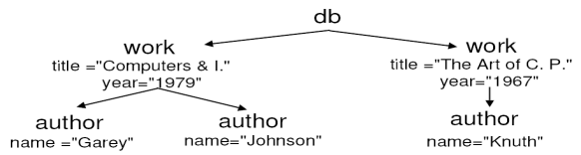
IV Data Exchange
Source
Targets
T
?
<!ELEMENT db (work*)>
<!ELEMENT work (author*)>
<!ATTLIST work title CDATA
#REQUIRED year CDATA>
<!ELEMENT author (EMPTY)>
<!ATTLIST author name CDATA #REQUIRED>
<!ELEMENT bib (livre*)>
<!ELEMENT livre (auteur+, titre , annee)>
<!ELEMENT auteur #PCDATA>
<!ELEMENT titre #PCDATA>
<!ELEMENT annee #PCDATA>
Data Exchange setting: (K_{S},τ,K_{T})
      [Fagin et al. 2002, Arenas, Libkin 2005]
Source-Consistency: Given a source structure I in K_{S}, is there a target J in K_{T} s.t. (I,J) in τ ?
Typechecking: Decide if for all I in K_{S} and all J s.t. (I,J) in τ, J is in K_{T}.
T
I
T
K _{S}
Notes:
I first start with the classical data exchange
then introduce the approximation based on property testing
and finally comes to the main subject which is approximate data exchange

Slide 28
size Independence
Consequences :
Membership Testers for regular languages can be used to decide
if w is ε-close to a consistent (or safe) input
  For any FSM (or XSL-transducer),the inverse image of a regular language is regular.
  Regular languages are closed by intersection and complementation.
Constant time decision
Independence to noise
H_{safe}
H_{consist}
Notes:
Chaque composante -> moyenne

Slide 29
Approximate Source Consistency
ε-Source-Consistency: Given a source structure I, is there a source I’∈K_{S}, ε-close to I s.t. τ(I’) is ε-close to K_{T} ?
T
H_{T}
Constant time decision

Slide 30
Approximate Source Consistency
T
H_{T}

Slide 31
V Applications
Practical transductions for visualization
  Unary Query
  Two Dimension Query
  Arbitrary Query
OLAP
Engine
Transduction
OLAP
Query
Cube
Visualization
Mondrian
XSLT program

Slide 32
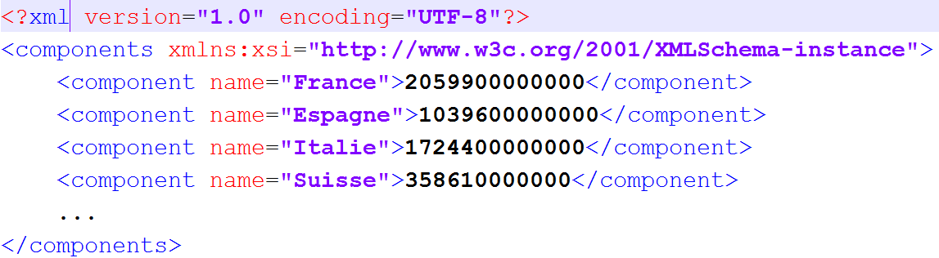
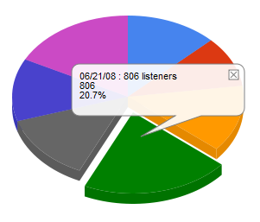
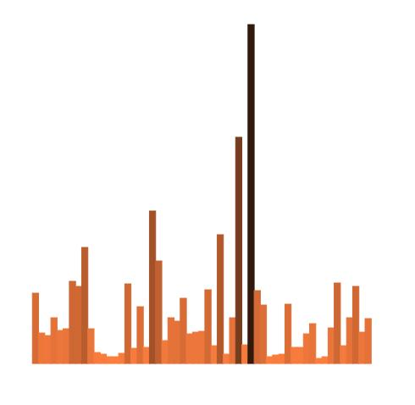
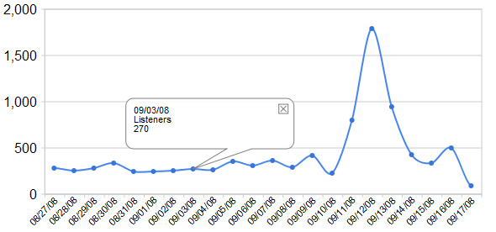
Example : Unary querY
XSLT
XHTML+API
SVG

Slide 33
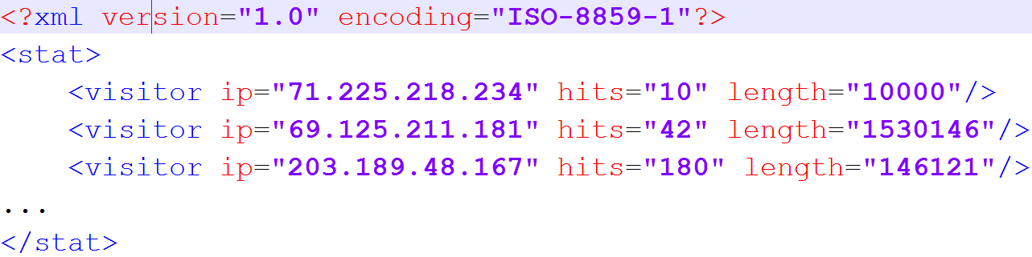
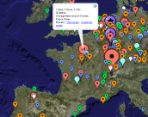
Example : 2 measures
IP
Date
Hour
Duration
IP
Date
Hour
Duration
•••
Ip with many hits
Ip with large length
Approximated with samples
even on a stream

Slide 34
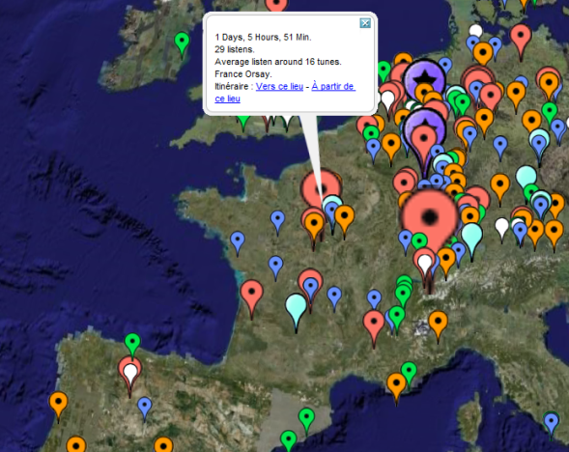
KML (google maps)
Notes:
Superimpose Maps

Slide 35
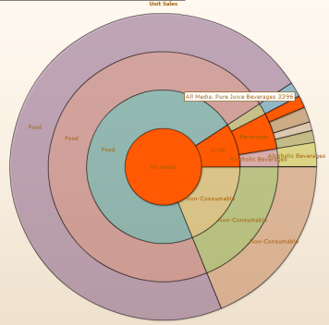
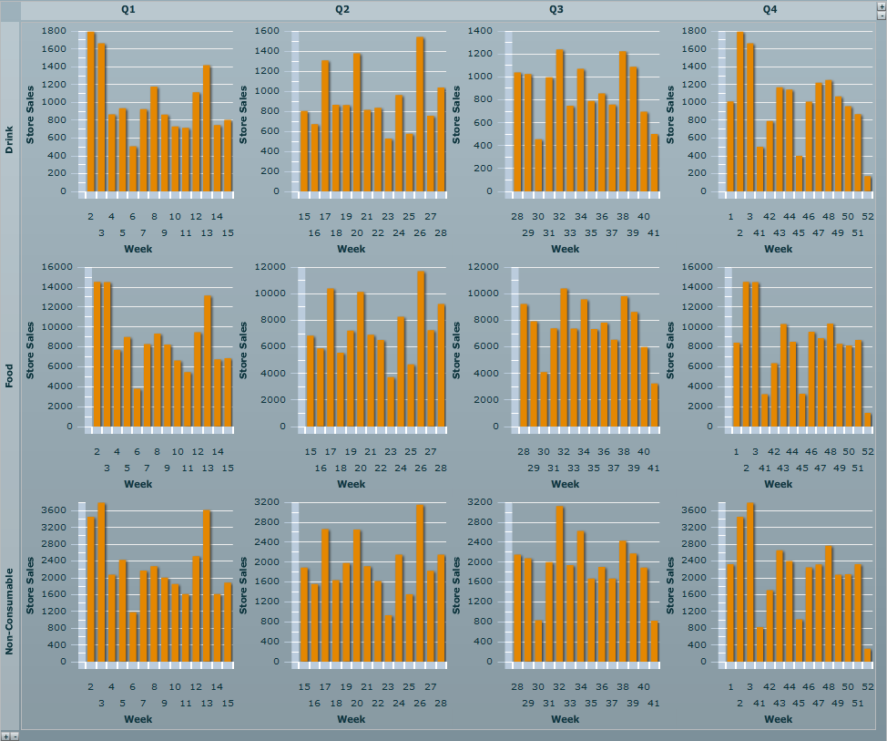
Arbitrary OLAP Query
VISIR (VISual InteRaction)
With N. Spyratos, M. de Rougemont, T. Sugibuchi, E. Simonenko
Detail a Dimension
Generalization
for several Dimensions

Slide 36
Conclusion
Statistics
    Generalization to transducers on words and unranked trees.
Approximate Equivalence
    Effective decision and a tractable restriction.
Data Exchange
    Approximate Consistency
      Constant time approximation Vs linear time decision.
    Approximate Type-checking
      PTIME approximation of a PSPACE complete problem.
    Applications to visualization
Omitted
    Inversion of statistics
    Approximate Data integration

